Slide 1


About Me:
My responsibilities include…
I work with _____ on…
Talk to me if you have an issue with…
Hobbies/Interests
True crime addict
Amateur violinist
Die hard fan of Die Hard franchise
Fun Facts:
I used to work as a waiter on the International Space Station
My dad works at Nintendo
I’ve built most of the furniture in my house
John Doe | Compliance Officer
Notes:
Click on the photo and select “Replace Image” in the toolbar. Replace the image with your preferred headshot.

Slide 2





About Me:
As a Compliance Officer, I handle all ethical concerns for the organization. That includes investigating reports, training everyone on ethical standards, and building policies and regulations.
Hobbies/Interests:
I’m a huge cinephile! Come talk to me about any new movies! I also love classical music and I’m a big TTRPG nerd (tabletop roleplaying games, for the layman).
Two Truths & a Lie:
I once got lost in the woods for a week! I can catch fish with my bare hands. I once dated Nicole Kidman.
John Doe | Compliance Officer
Notes:
Showcase your personality! Include some images of your favorite things in this graphic! (More instructions below)
To collect images with backgrounds, find the image online, download them, and upload them to https://www.remove.bg/ to create a perfect png.
Then select the images here and then click “Replace Image” on the toolbar above.
Click on the photo and select “Replace Image” in the toolbar.
Replace the image with your preferred headshot.

Slide 3

Biography:
I was born in raised right here! Hit me up if you’re looking for restaurant recommendations!
Hobbies/ Current Interests:
Huge stand-up fan!
Outdoors - I love camping!
Painting - I’m currently trying to keep up with Bob Ross
Two Truths & a Lie:
I once got lost in the woods for a week!
I can catch fish with my bare hands.
I once dated Nicole Kidman.
John Doe | Compliance Officer
Notes:
Click on the photo and select “Replace Image” in the toolbar. Replace the image with your preferred headshot.

Slide 4
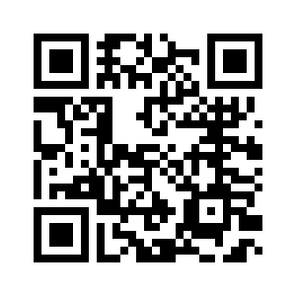
You Can Always Talk To Us!
As your Ethics & Compliance team, it’s our job to listen to you! Speak Up if you feel something is not right in your workplace!
Contact Us: ###-###-####
Notes:
Add your hotline number at the bottom to ensure everyone knows how to reach out to your team! (More instructions below)
If you have an online reporting tool, copy the link into https://www.qr-code-generator.com/ to create a QR code.
Select the example QR code here and click on “Replace Image” on the toolbar above. Replace the image with your own.

